Slide 1

ELECTRONIC VOTING
MACHINE
Under The Supervision of:
Mr. Sachin Sharma
(Asst. Professor)
Department of CEA
GLA University, Mathura (281406)
Presented By:-
PRACHI AGRAWAL (2215001245)
SOMYA RAWAT (2215001758)
SUHANI GOYAL (2215001791)
SARTHAK GUPTA (2215001590)
TARUN KUMAR SOROUT (2215001849)

Slide 2

Content
Introduction
Objective
Advantages of E.V.M.
Tools and Technology
Code of E.V.M.
Output
Old methods of voting
Conclusion

Slide 3

Introduction
Electronic Voting Machine is a System that enables the voters to submit their valuable vote online .
The Indian Electronic Voting Machine (EVM) were developed in 1989 by Election Commission of India in collaboration with h Bharat Electronics Limited and Electronics Corporation of India Limited. The Industrial designers of the EVMs were faculty members at the Industrial Design Centre, IIT Bombay.
The voter needs to select their favourite candidate to the system and the machine automatically calculate the percentage votes and gives the result.
EVM is a time saving machine .
The admin can start or end the voting any time.
The election will conduct under the supervision of observer.

Slide 4

OBJECTIVE
To make an Electronic Voting Machine for the selection of Class Representative and we can use this for the selection of mess in-charge etc.
The objective is to remove these major problems in the present system:-
More human effort required.
Time consuming.
Difficult to organize.
Lack of participation.
Problem of Inconsistency.

Slide 5

Advantages of E.V.M.
1 . Speed and accuracy: EVMs are designed to count votes quickly and accurately. They can count votes at a much faster pace than traditional paper ballots, which reduces the time required to announce election results.
2 . Reduced errors: EVMs reduce the chances of errors in vote counting, as they do not rely on manual counting of ballots. The use of EVMs ensures that the final results are accurate and error-free.
3 . Accessibility: EVMs make voting easier and more accessible for voters with disabilities or those who have difficulty reading or writing. This is because EVMs can be designed to have larger fonts and provide audio assistance.

Slide 6

4 . Security: EVMs are designed to prevent vote tampering and ensure the integrity of the election process. They have features such as encryption and password protection, which make it difficult for anyone to manipulate the voting results.
5 . Cost-effective: EVMs can be a cost-effective alternative to traditional paper ballots in the long run. While there is an initial investment in purchasing EVMs, the cost of printing paper ballots and the cost of manual vote counting are eliminated.

Slide 7

Tools And Technology
PYTHON:
Python is an interpreted, object-oriented, high-level programming language with dynamic semantics. Its high-level built in data structures, combined with dynamic typing and dynamic binding, make it very attractive for Rapid Application Development, as well as for use as a scripting or glue language to connect existing components together. Python's simple, easy to learn syntax emphasizes readability and therefore reduces the cost of program maintenance. Python supports modules and packages, which encourages program modularity and code reuse. The Python interpreter and the extensive standard library are available in source or binary form without charge for all major platforms, and can be freely distributed.

Slide 8
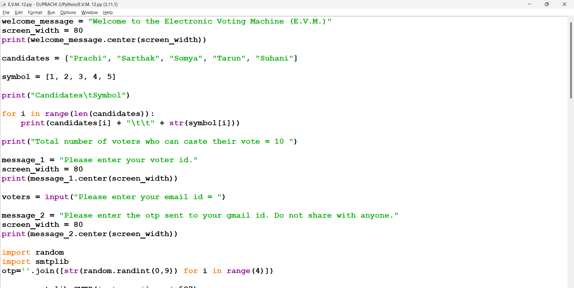
Code for E.V.M.

Slide 9
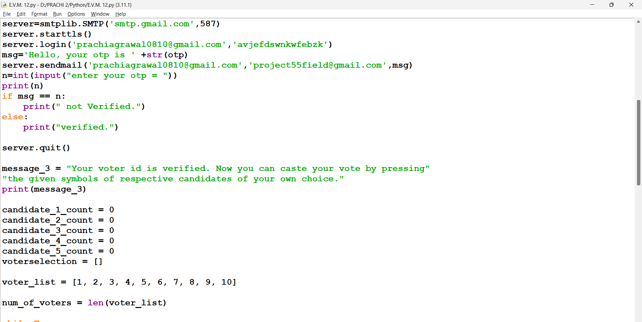

Slide 10
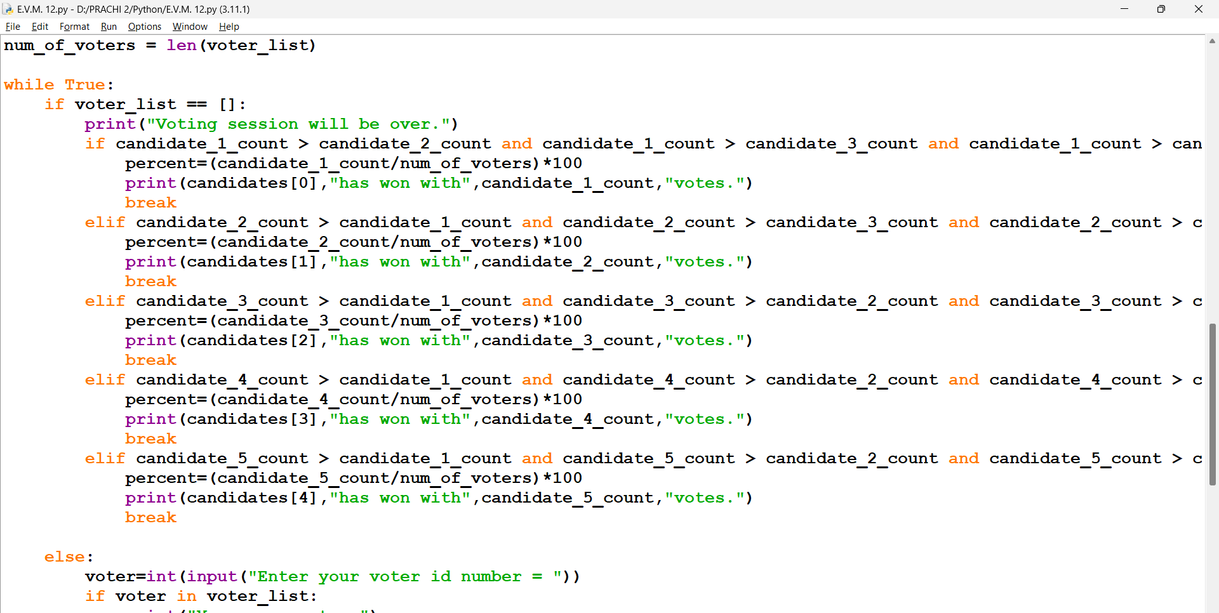

Slide 11
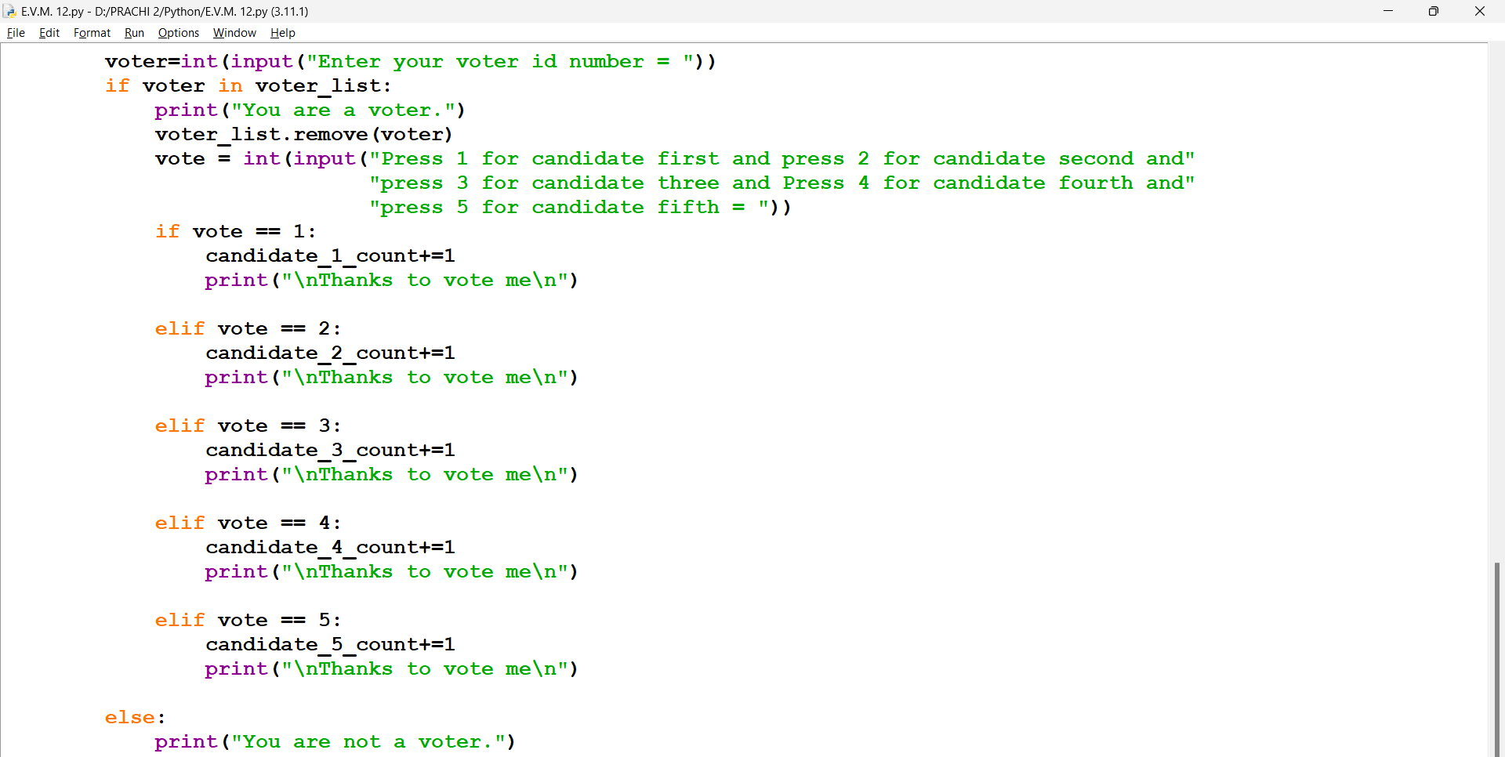

Slide 12
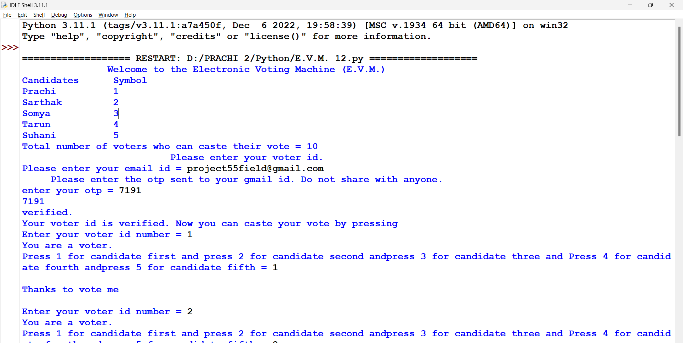
Output

Slide 13
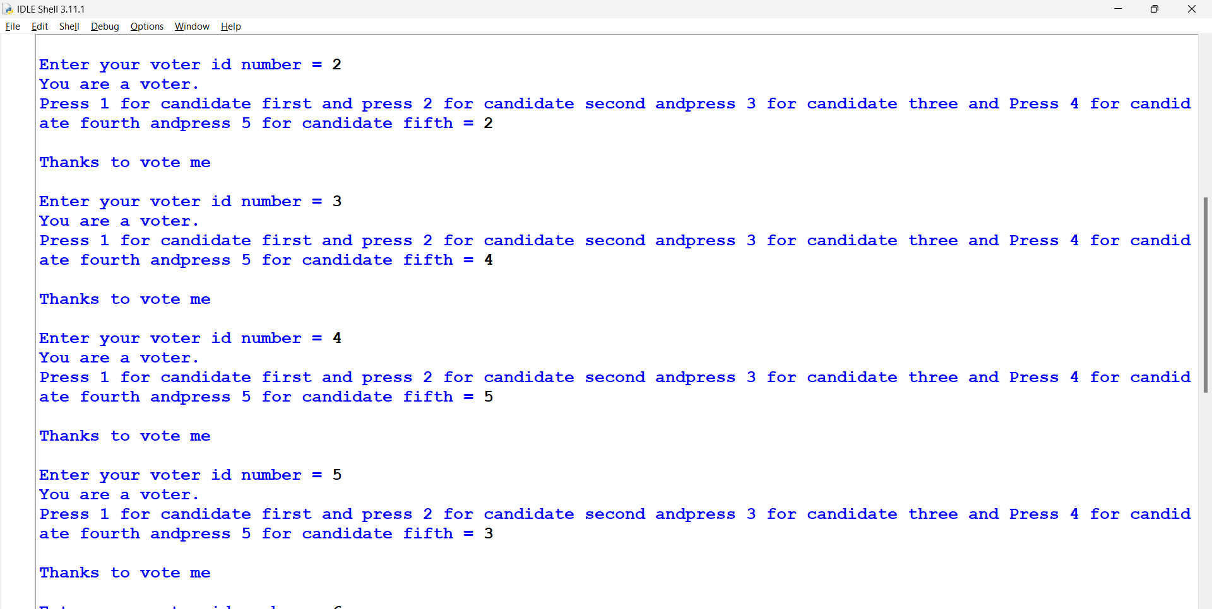

Slide 14
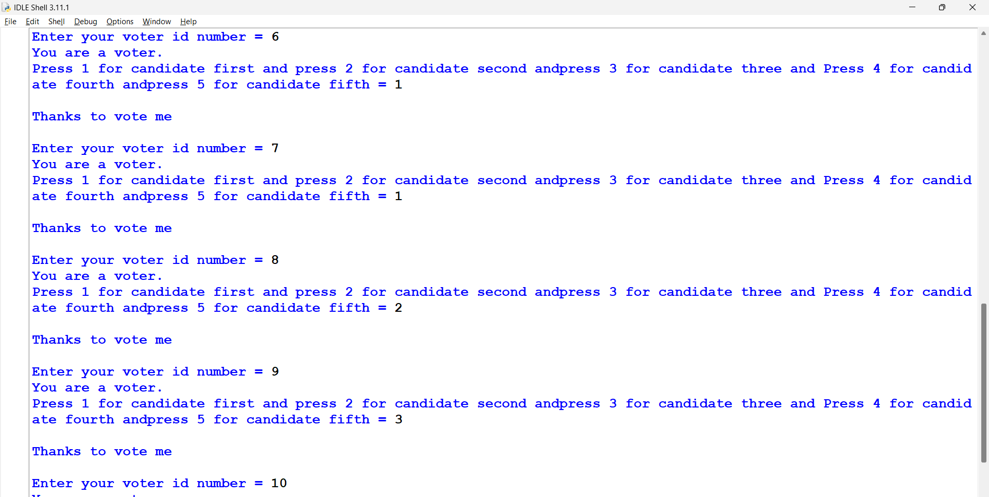

Slide 15
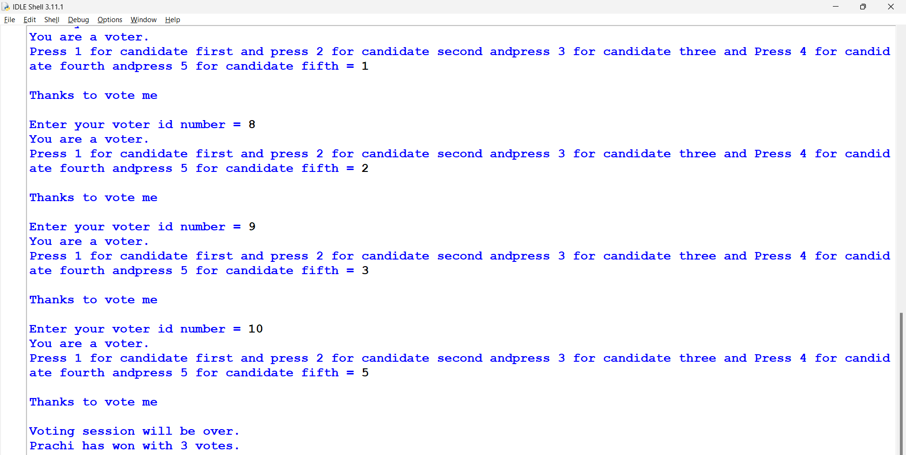

Slide 16
OLD METHODS OF VOTING
Paper Based Voting : The voters gets a blank ballot and use a pen or a marker to indicate he want to vote for which candidate.
Lever voting machine : Lever machine is peculiar equipment, and each lever is assigned for a corresponding candidate.
Direct recording electronic voting machine : This type , which is abbreviated to DRE integrates with keyboard; touch screen, or bottoms for the vote to poll.

Slide 17

Conclusion
Reduces human efforts .
Steps ahead in technology .
Reduces paper work .
Reduces time .

Slide 18
THANK YOU!!!

